Slide 1
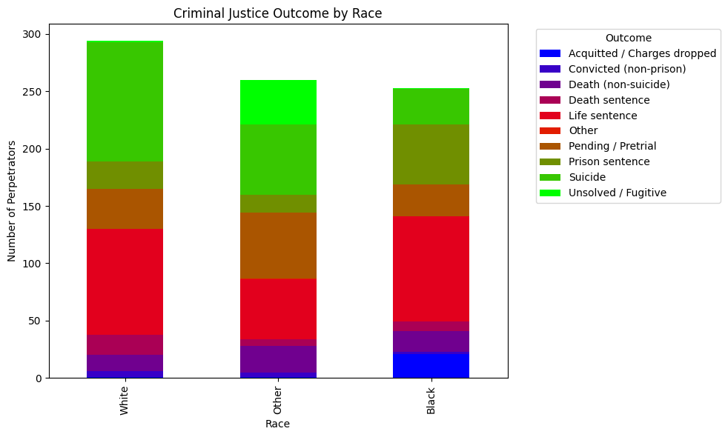
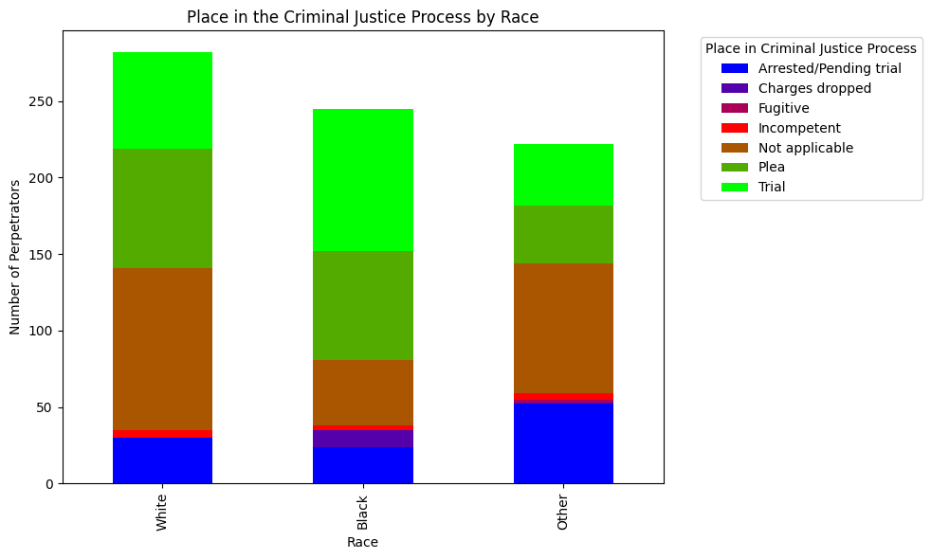
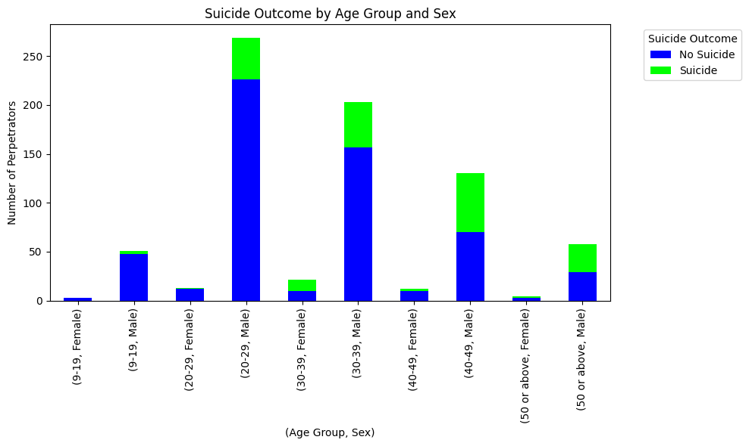
Mass Killings in America: Demographics, Outcomes, Process and Suicidality
Brynna Garden & Paige Toth
Rollins School of Public Health | Emory University
Introduction
Graphs
Results
The Mass Killings dataset contains all mass killings (4 or more people) in the United States from 2006 to the present day. Variables include offender id, first name, middle name, last name, age, race, sex, suicide, cause of death, outcome, criminal justice process, sentence type, and sentence details.
Paige and Brynna are both in the injury and violence prevention certificate at Rollins, thus, are both very interested in understanding outcomes and variables related to violence and the criminal justice system, especially in the United States. This dataset will allow the researchers to investigate criminal justice outcomes following a mass killing against different demographics and suicidality.
Criminal Justice Outcome by Race
After conducting the chi-square analysis, we reject the null hypothesis and find that there is a significant correlation between race and criminal justice outcome in this sample (X² = 207.72, df = 18, p-value = 2.84).
Place in the Criminal Justice Process by Race
After conducting the chi-square analysis, we reject the null hypothesis and find that there is a significant correlation between race and where the offender is in the criminal justice process following a mass killing (X² = 93.38, df = 12, p-value = 1.09).
Suicide Outcome by Age Group and Sex
After conducting the chi-square analysis, we reject the null hypothesis and find that there is a significant correlation between age, sex, and the outcome of suicide in this sample (X² = 82.87, df = 9, p-value = 4.34).
Research Questions
What is the association between race and offenders' criminal justice outcome following a mass killing?
What is the association between race and where the offender is in the criminal justice process following a mass killing?
What is the association between demographic variables (i.e., age and sex) and whether the offender died by suicide following a mass killing?
Methods
Conclusion
The five variables of interest in this analysis of the Mass Killings in America 2006 to Present dataset are race, age, sex, outcome, and criminal justice process. The pandas, numpy, and os packages in Pycharm were used to conduct statistical analyses and create graphs. All of the variables are categorical. Univariate analysis for all variables will include examination of frequencies and proportions. Descriptive statistics for all variables will be visualized using stacked bar charts. Chi-square tests will be used to answer all of the research questions. All analyses will be performed using Pycharm (version JCEF 122.1.9).
Based on our evaluation, we can infer there is a significant correlation between criminal justice outcome and race, place in the criminal justice process and race, and suicide outcome by age group and sex. We are limited in our analysis by way of it being a secondary data analysis and by having only quantitative data as to why a perpetrator may commit a mass murder.
Further research is necessary to determine true causation between demographics, risks of perpetrating a mass killing, and adverse outcomes, such as suicide, following a mass killing.

